Slide 1
PROVENANCE FOR INTERNET ART: USING THE W3C PROV DATA MODEL
iPRES, AMSTERDAM, 19.09.2019
LOZANA ROSSENOVA, DR KARIN DE WILD, DRAGAN ESPENSCHIED

Slide 2
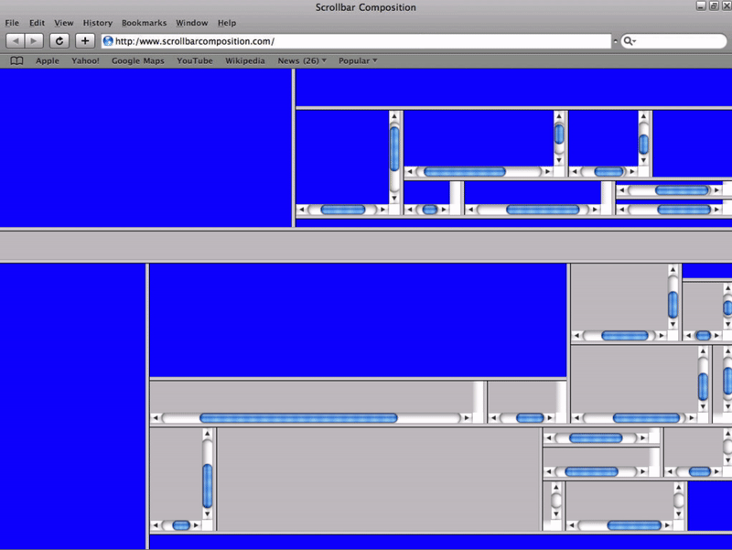
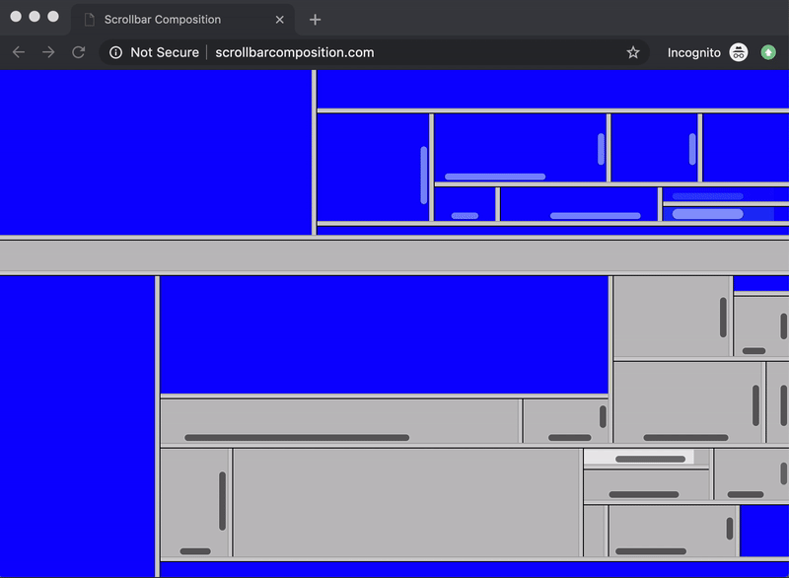
WHAT IS INTERNET ART?
Jan Robert Leegte, “untitled[scrollbars]” (1997-2000)

Slide 3
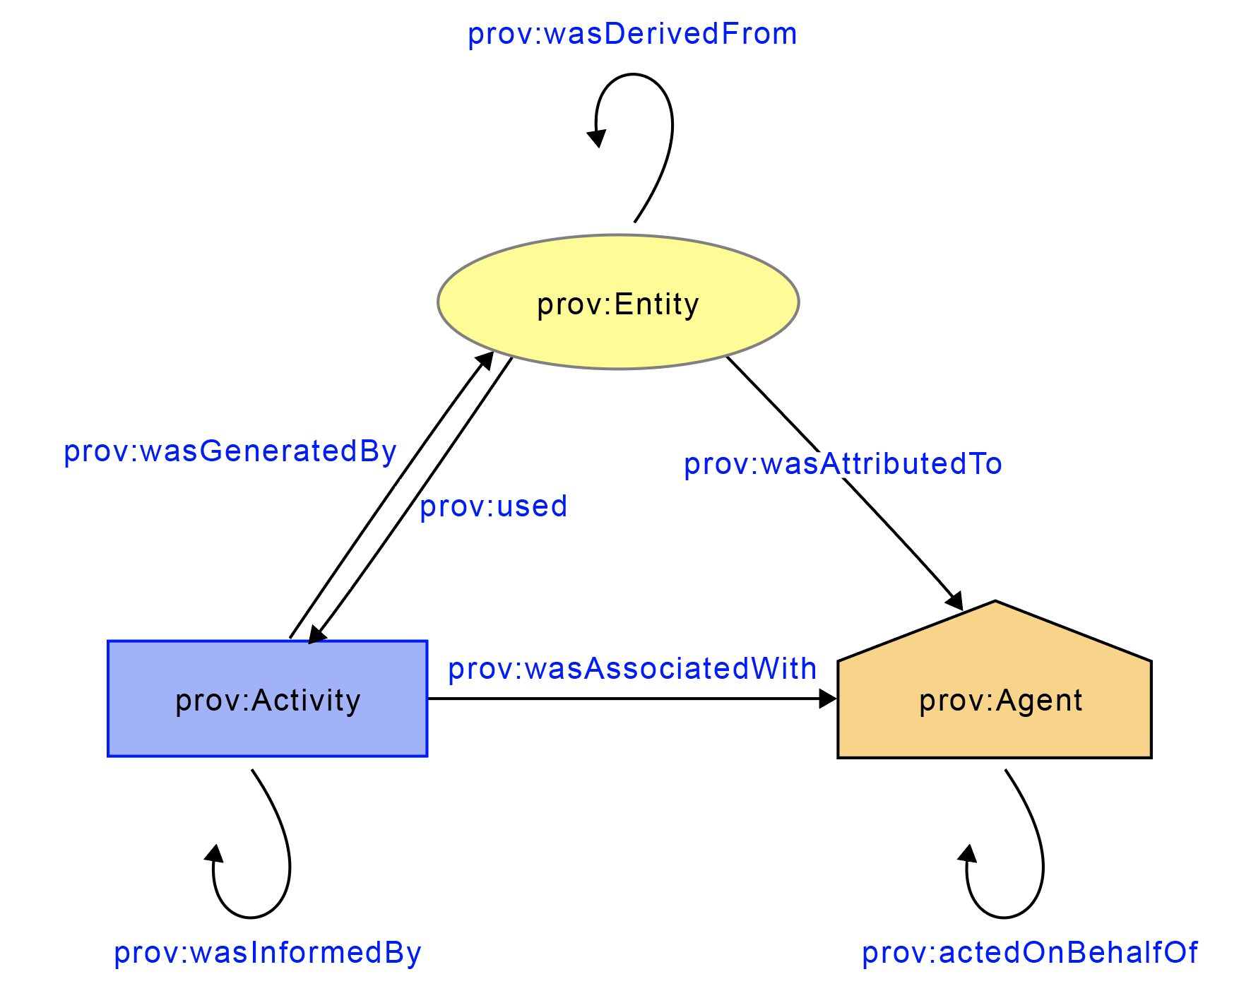
WHAT IS PROV?

Slide 4
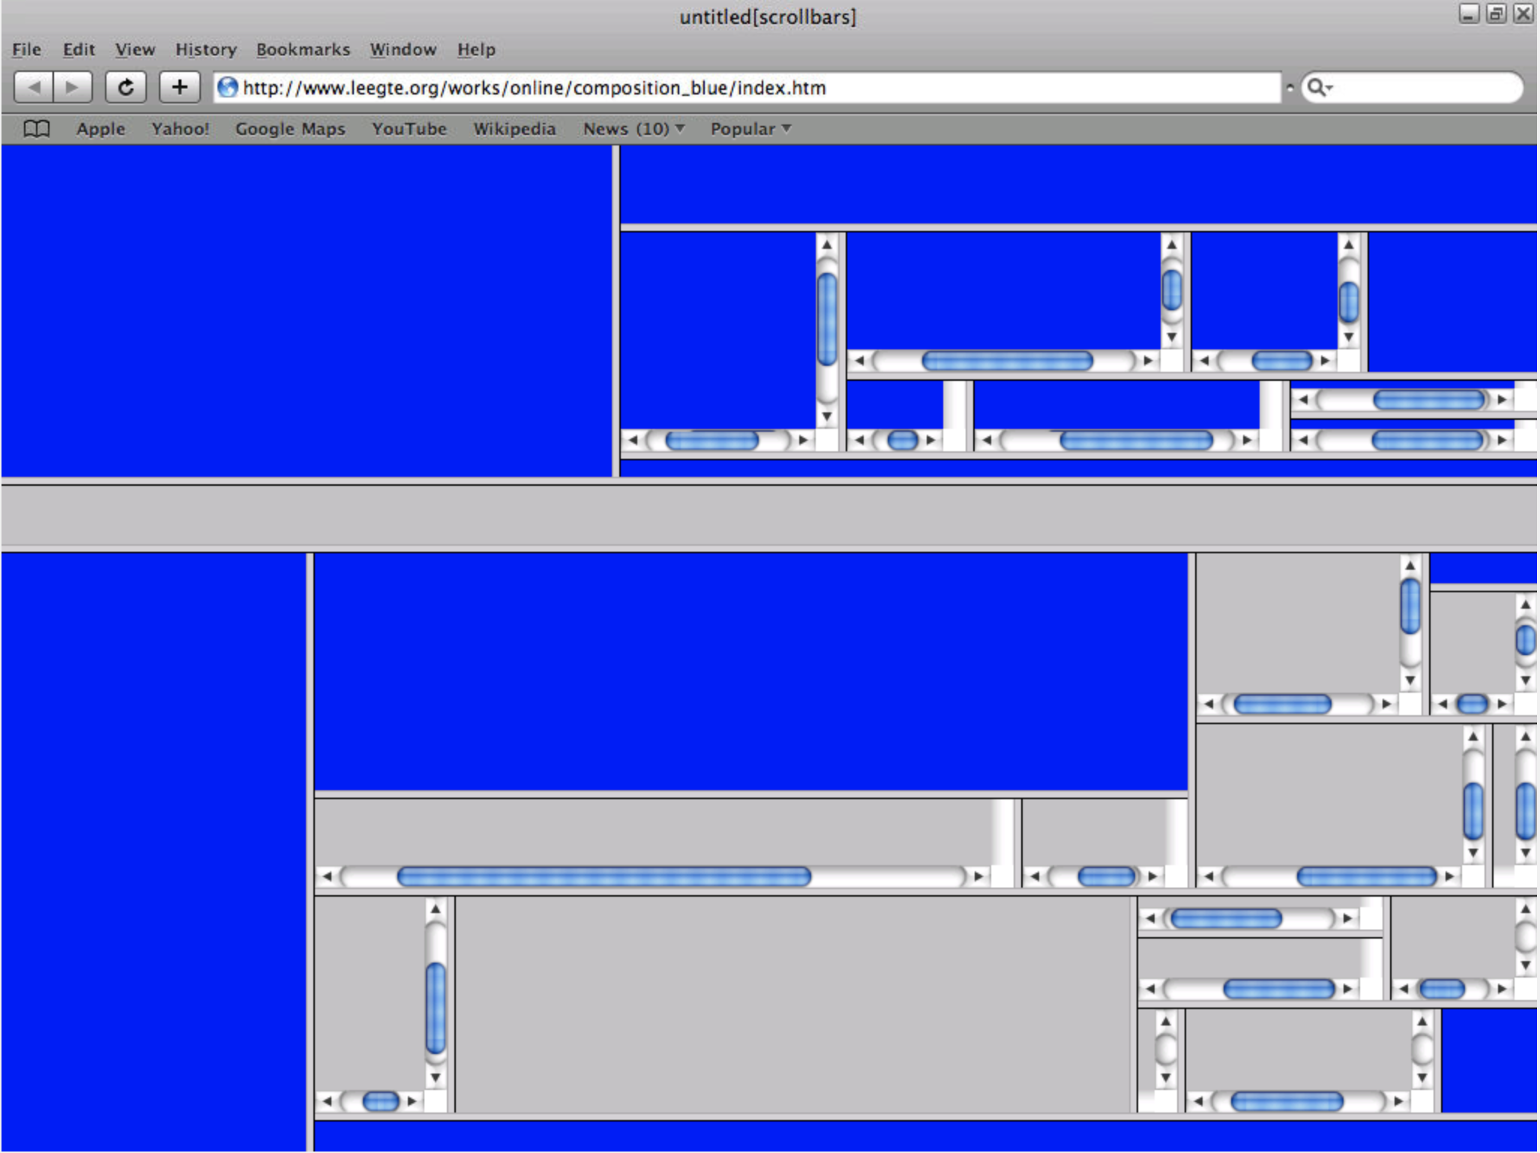
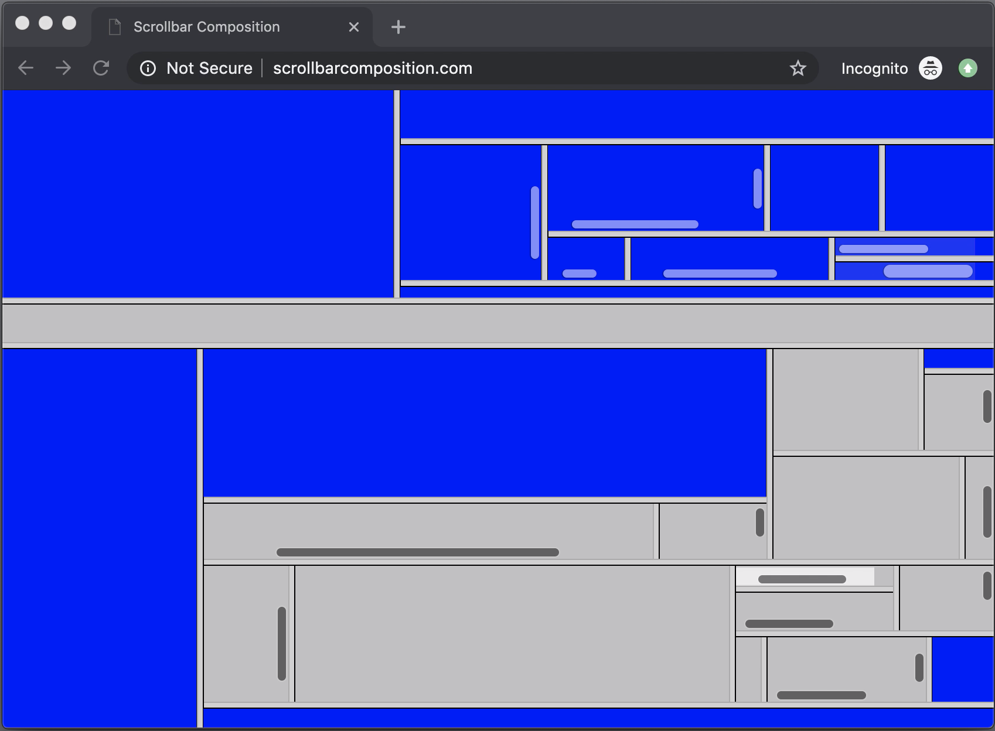
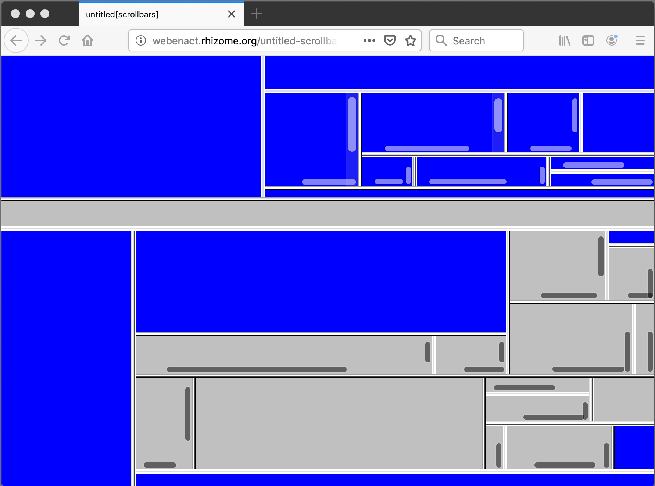
WHY PROV FOR INTERNET ART?
http://www.leegte.org/works/online/composition_blue/index.htm
http://scrollbarcomposition.com/
http://webenact.rhizome.org/untitled-scrollbars/20150713163150/http://www.leegte.org/works/online/composition_blue/index.htm
Safari 3.2.3 via oldweb.today
Chrome 76.0.3
Firefox 68.0.2

Slide 5
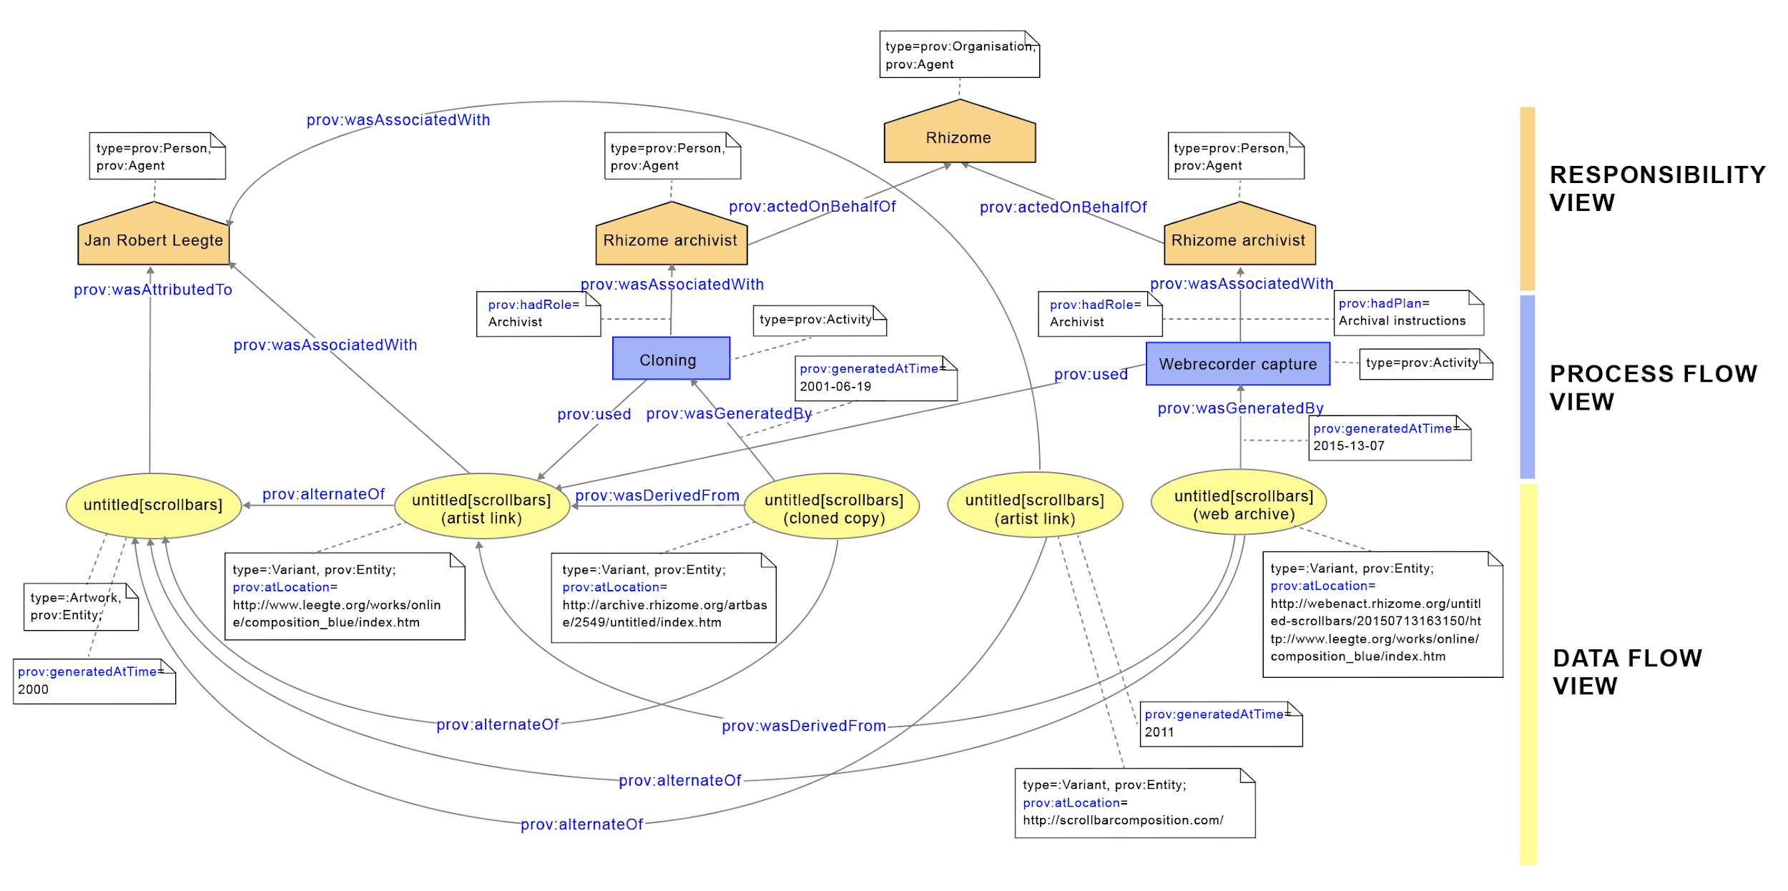
APPLICATION OF PROV-DM

Slide 6
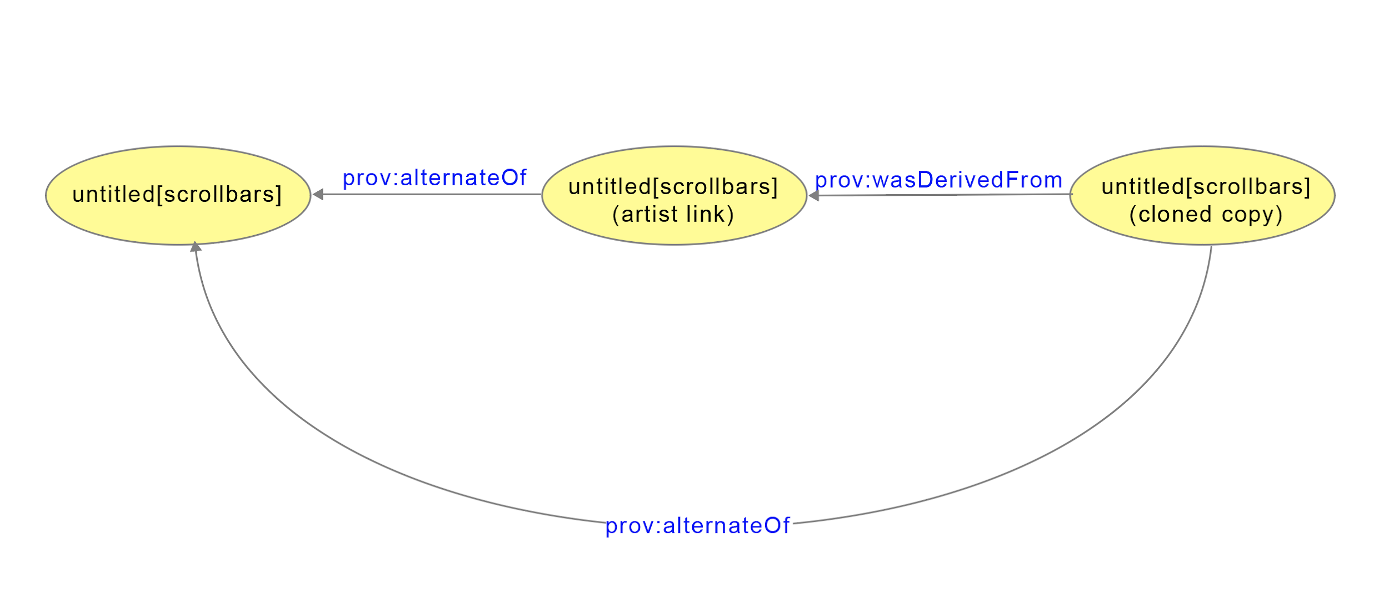
DATA FLOW VIEW

Slide 7
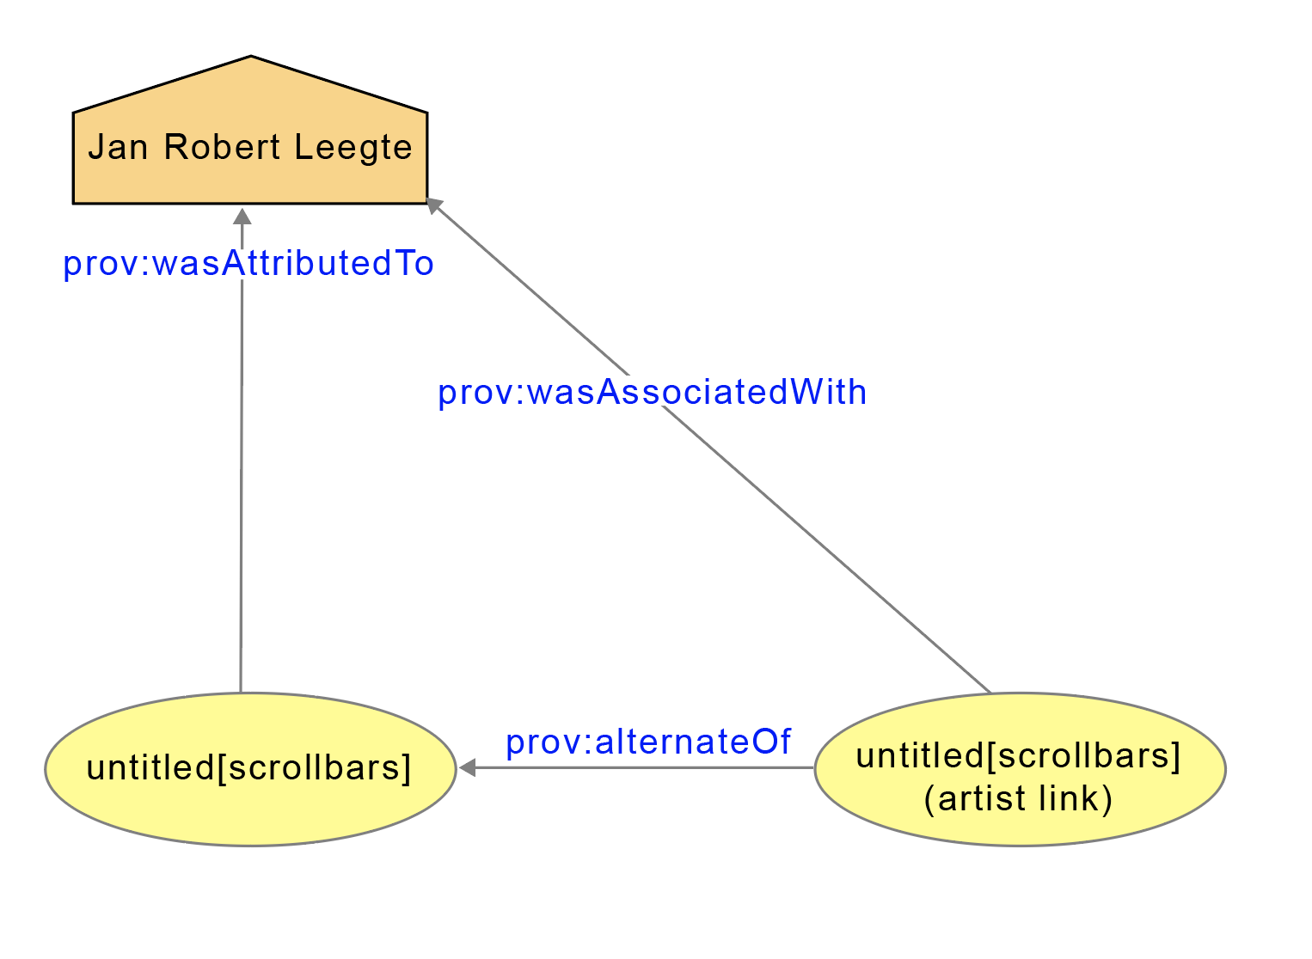
2. RESPONSIBILITY VIEW

Slide 8
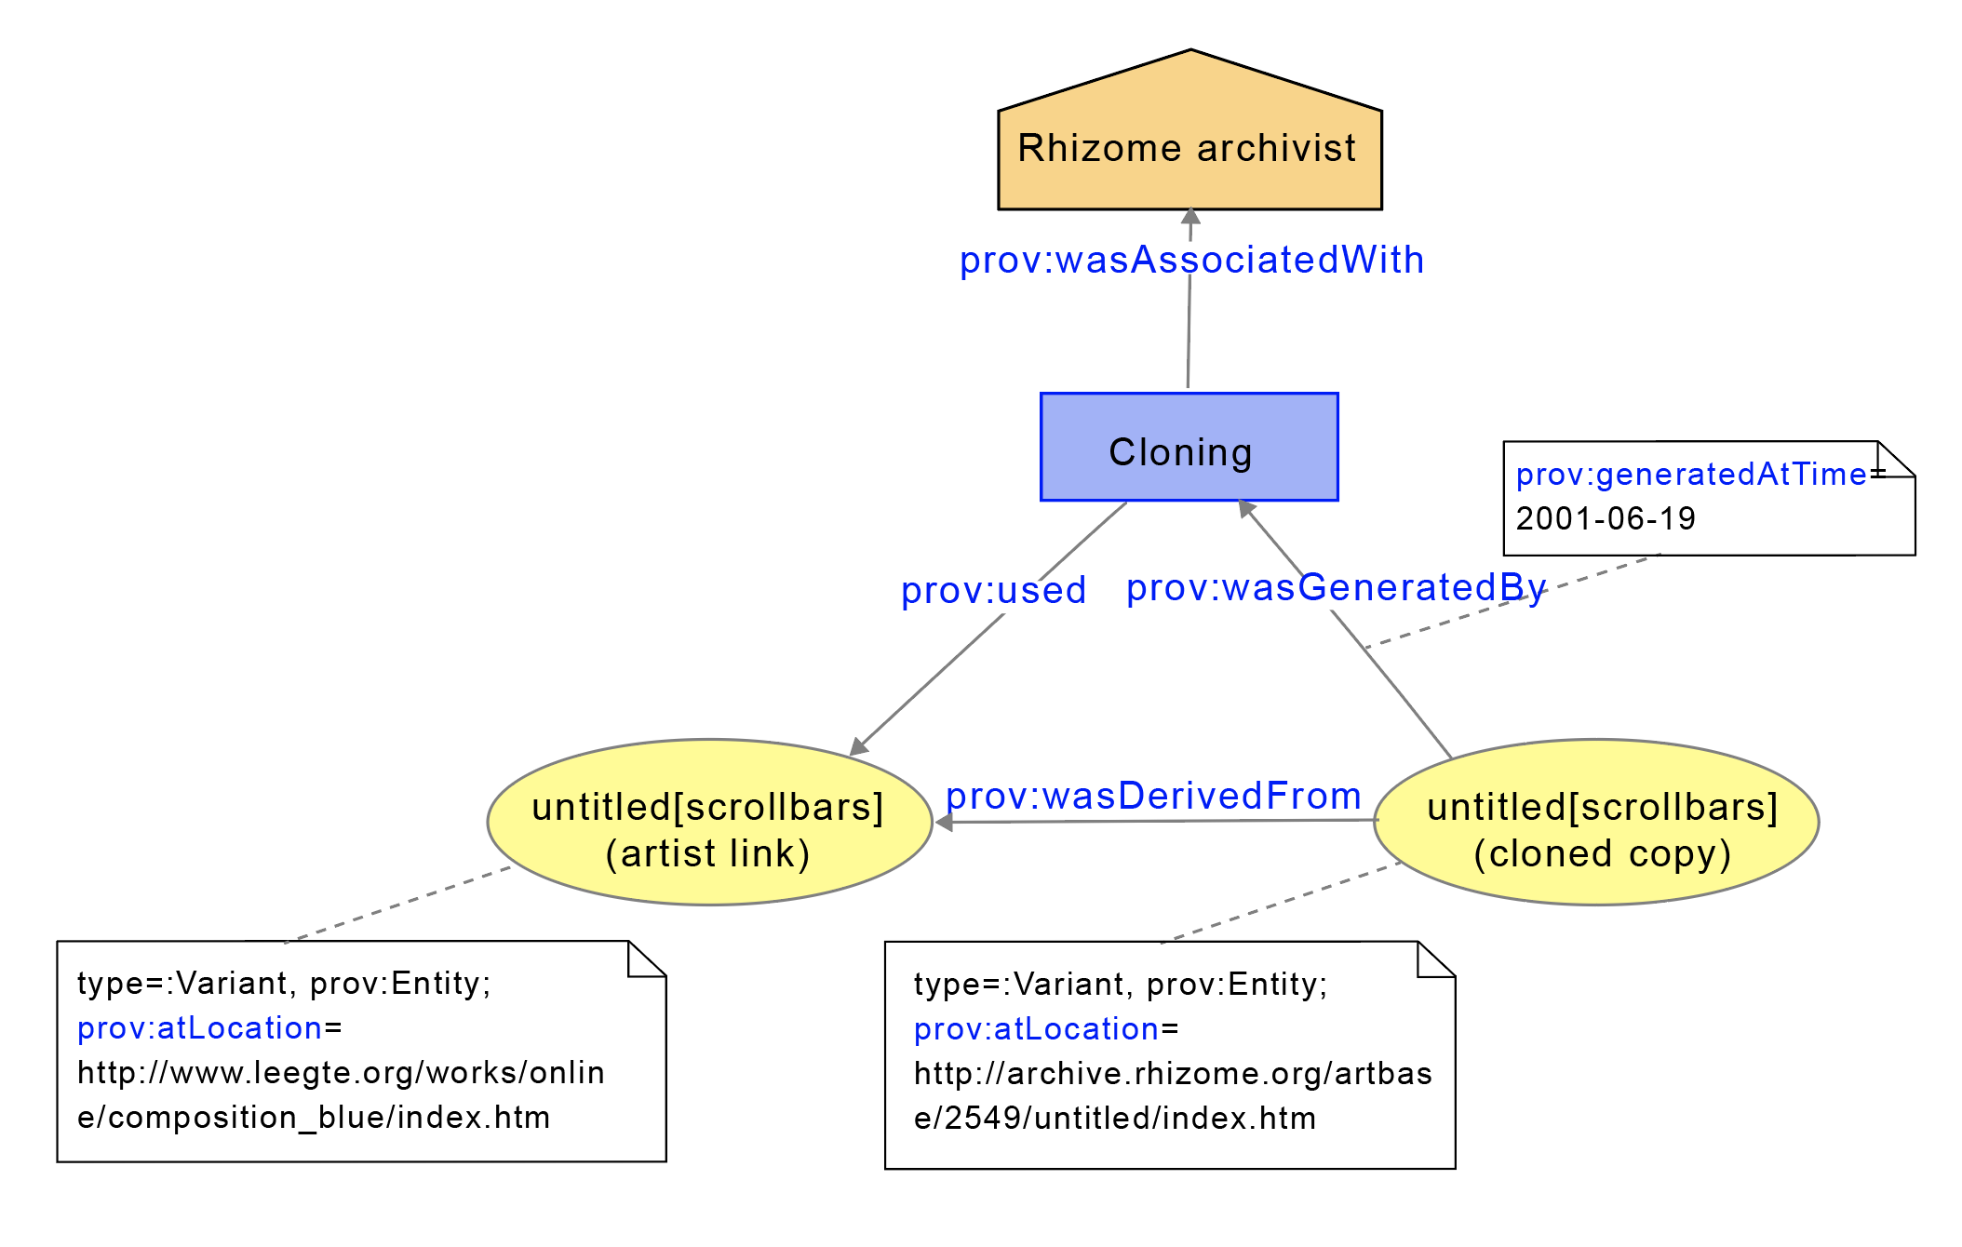
3. PROCESS FLOW VIEW

Slide 9
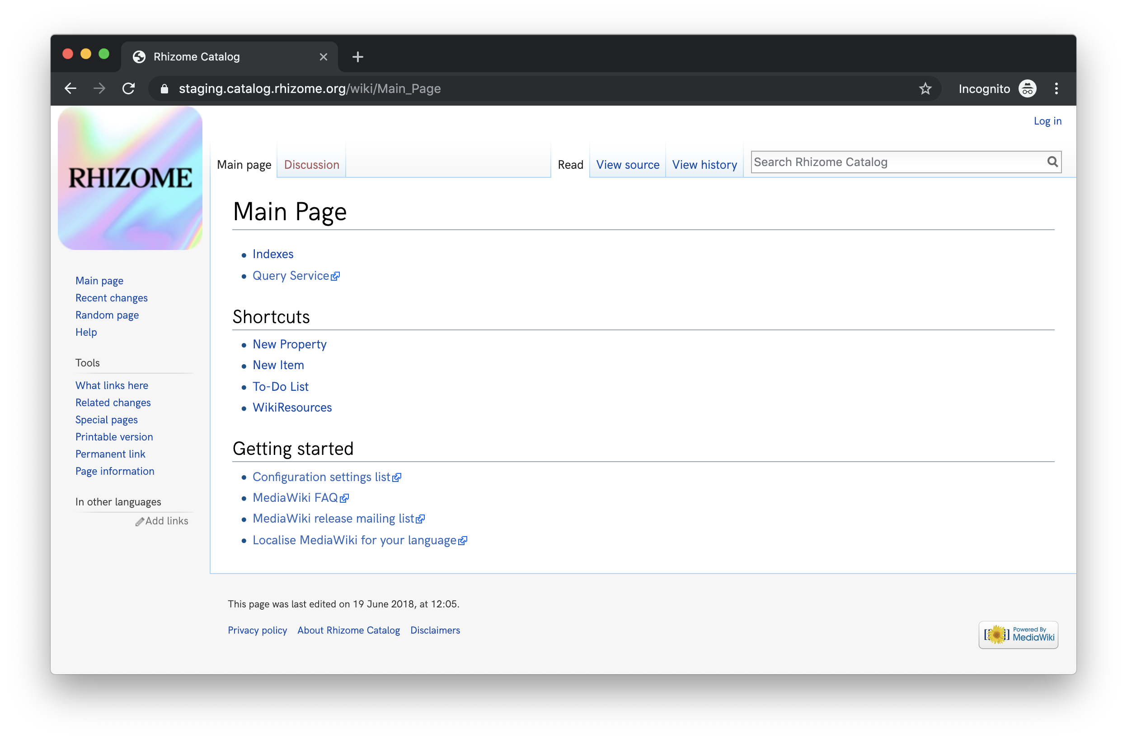
IMPLEMENTATION IN ARTBASE
https://staging.catalog.rhizome.org/wiki/Main_Page

Slide 10


WHAT IS WIKIBASE?
PUBLIC
PRIVATE
Open Source Linked Data Management System

Slide 11
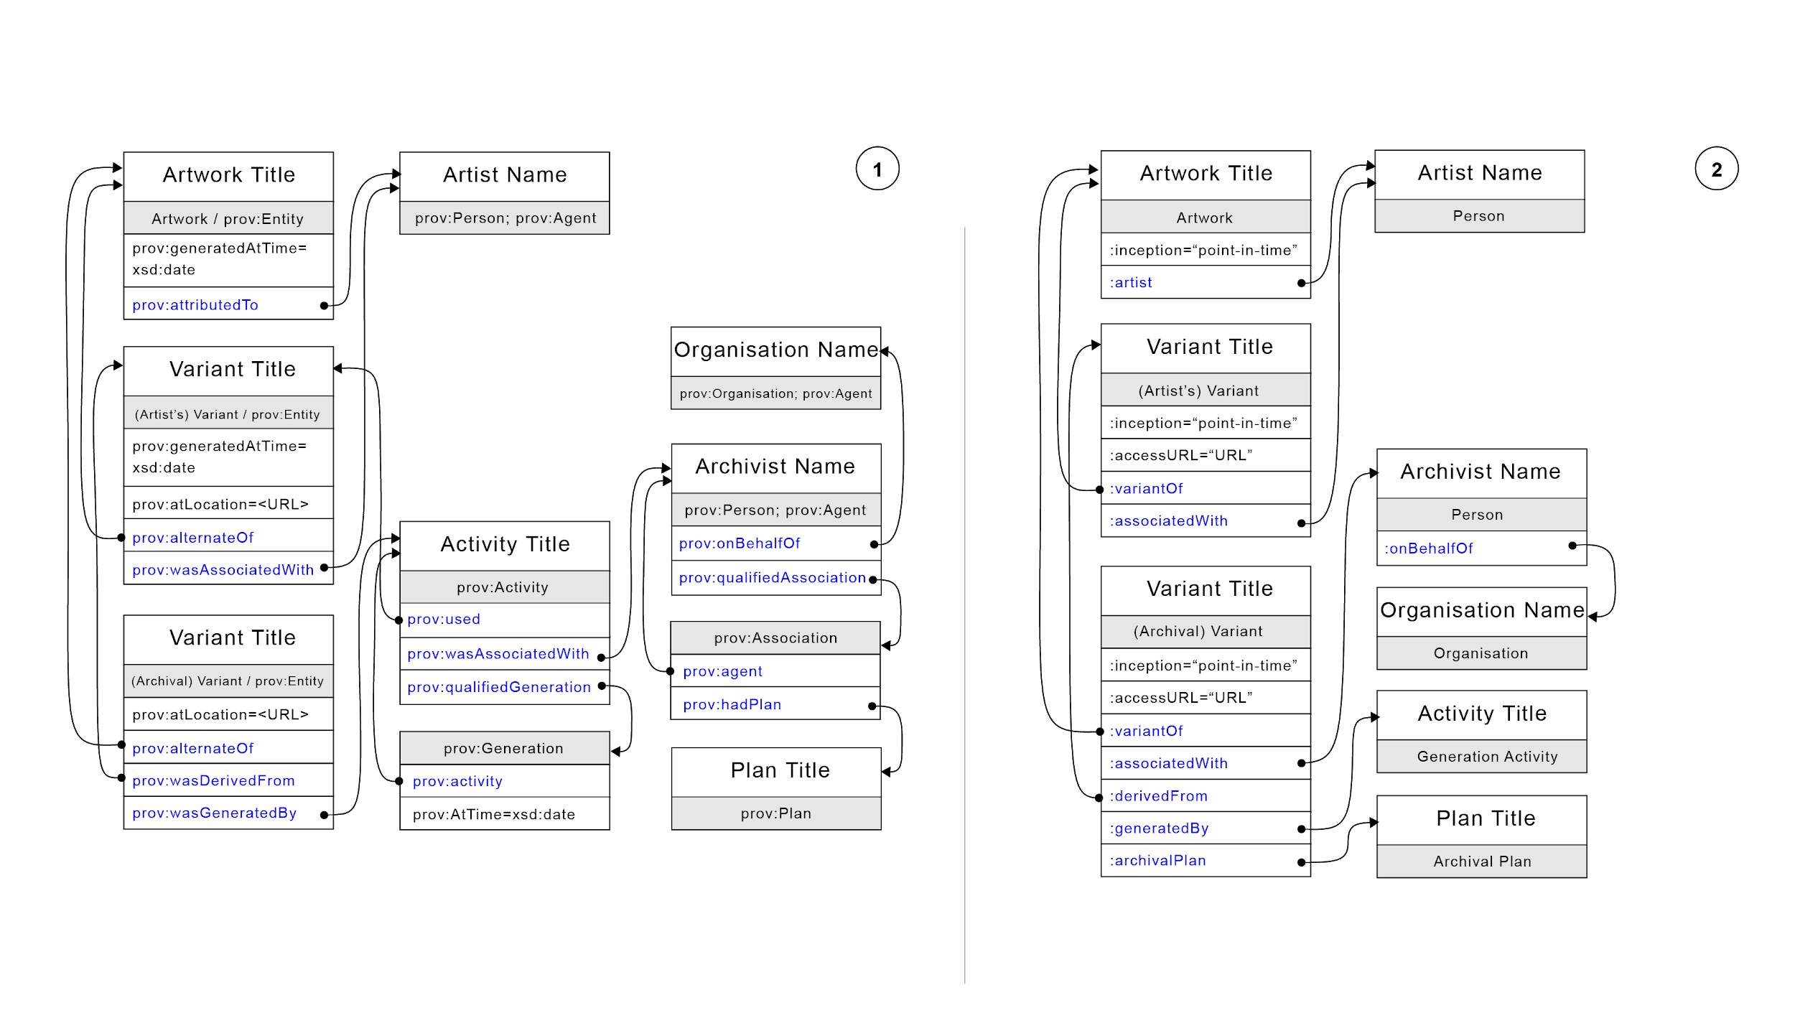
MAPPING CONCEPTS & PROPERTIES
PROV-DM application for the ArtBase case study
PROV implementation into Wikibase

Slide 12
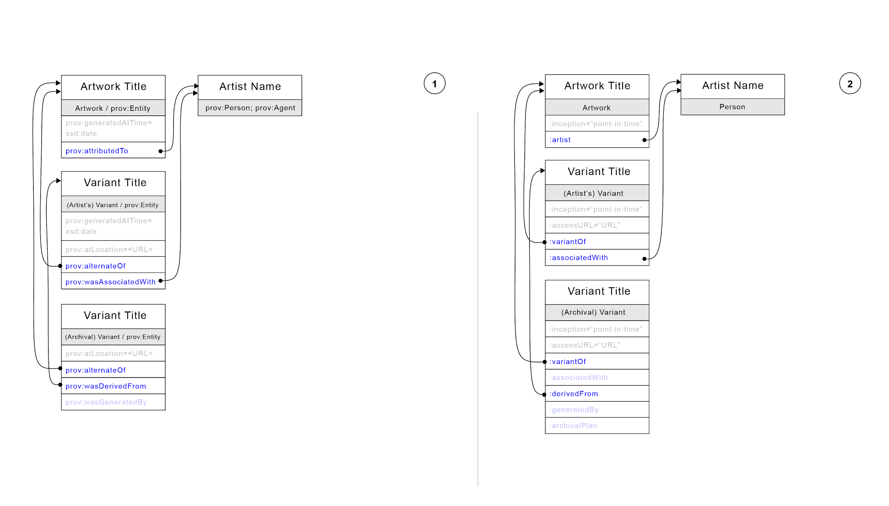
MAPPING CONCEPTS & PROPERTIES
PROV-DM application for the ArtBase case study
PROV implementation into Wikibase

Slide 13
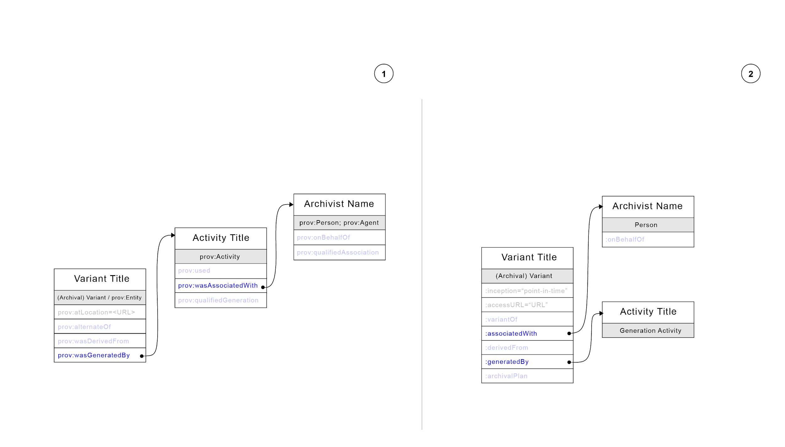
MAPPING CONCEPTS & PROPERTIES
PROV-DM application for the ArtBase case study
PROV implementation into Wikibase

Slide 14
NEXT STEPS
Further testing with different artworks.
Collaboration with the Wikimedia Foundation and Wikimedia community.
Better integration of PROV-DM into Wikidata RDF expressions.

Slide 15

Thank you! Any questions?

